Slide 1
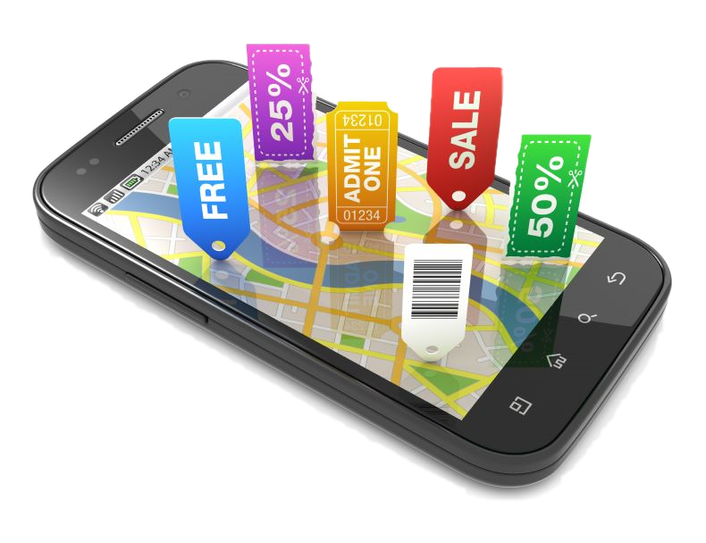
Customer Tracking System

Slide 2
Group Details
Supervisor:
Ms.Manori Gamage
Student Name | Student ID
Saluwadana S.M.R.B. | IT16072848
Jayasinghe L.M.R. | IT16113978
Hemachandra K.A.N.W. | IT16139640
Ahnaf H.M. | IT16139718
Research Area :
Machine Learning

Slide 3
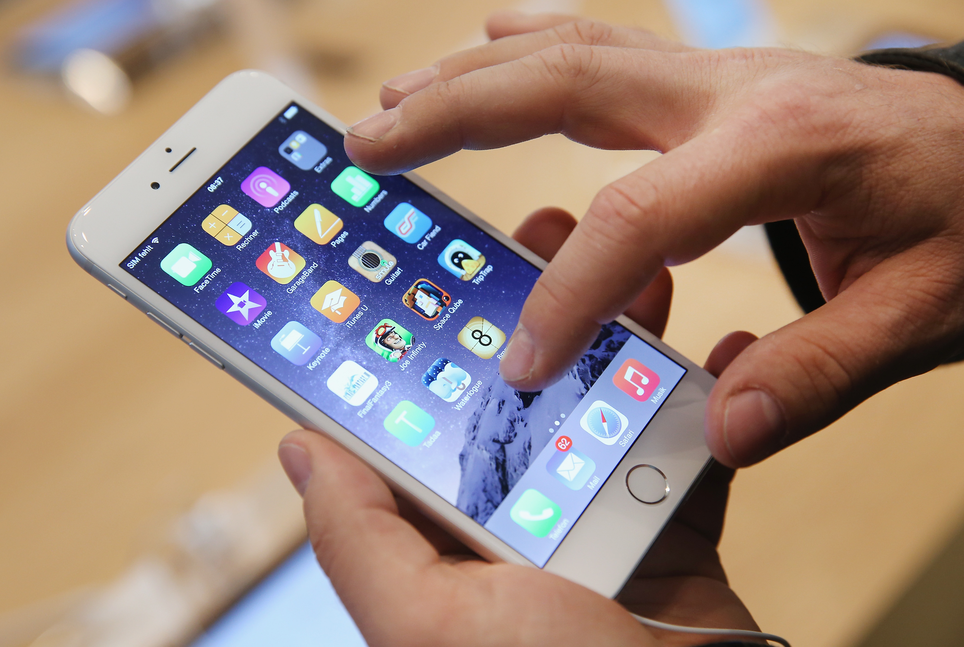







Agenda

Slide 4
Problem Definition

Slide 5

Problem Statements
Though people are interested on different offers, there is no proper location based system to notify customers about them.
Existing systems has no proper categorization.
Might have visit websites of each shops to find out offers.
Although merchants send messages about promotional
programs once customer buy something, it is not much
effective when considering about the business value.

Slide 6
Research Gap
 | Feature | Webengage.com | ODEL | Groupon.com | Proposed System
1. | Location based notifications | No | Yes | No | Yes
2. | Gather existing offers using public FB pages and shop's website | No | No | No | Yes
3 | Prioritize offers according to customer's behaviour | No | No | No | Yes
4 | Listed down offers | Yes | No | Yes | Yes

Slide 7
Objectives

Slide 8
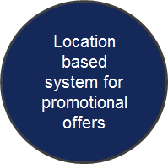
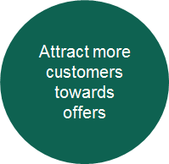

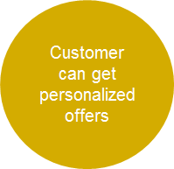
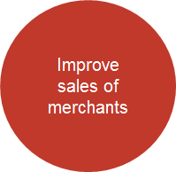
Main Objectives

Slide 9

Proposed Solution
Cross platform mobile application which is capable of providing personalized offers and promotions to users while helping merchants to improve their sales.

Slide 10

Business Value
Mr. Amitha Amarasinghe
Chief Operating Officer
Neo@Ogilvy(Pvt) Ltd
Sri Lanka

Slide 11
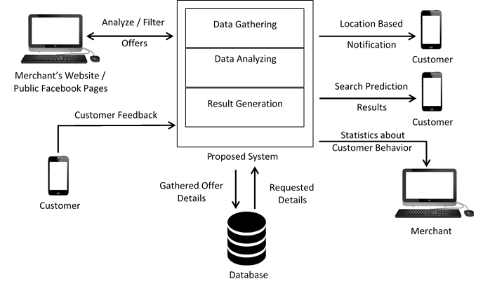
System Architecture

Slide 12
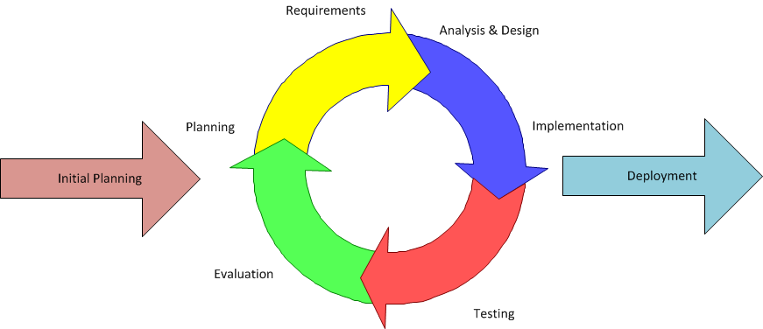
Project Development Process

Slide 13
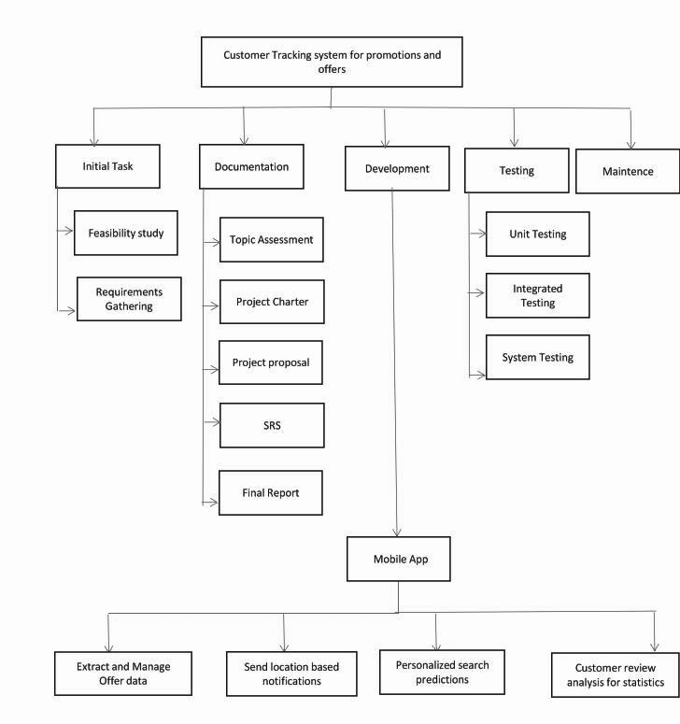
Work Breakdown Structure
Notes:
Need to modify

Slide 14
Methodology

Slide 15
Specific Objectives
Extract and manage offer data
Send location based notifications
Personalized search predictions
Customer review analysis for statistics

Slide 16
Extract and manage offer data
Send location based notifications
Personalized search predictions
Customer review analysis for statistics

Slide 17
Identify and Extract Offers
IT16113978 - Jayasinghe L.M.R.
Referring images of public Facebook pages or websites of registered merchants.
Extract text from images by using Machine Learning Algorithms.
Filter out offer details by using a classification algorithm.
Offer Details
Identified images
Hybrid
Algorithm
Classification Algorithm
Edge Based /Connected Component Algorithm
Extracted Text

Slide 18
Existing Text Extraction Methods
IT16113978 - Jayasinghe L.M.R.
Text Extraction Method | Drawbacks
Region Based Method | Not strong for complex background images
Connected Component Based Method | Extract text quickly but fails in complex background
Edge Based Method | Not powerful to handle large size text [2]
Texture Based Method | Large computational complexity

Slide 19

Self Evaluation Plan
IT16113978 - Jayasinghe L.M.R.
Research on text extraction methods and finding out the drawbacks of them.
Modify the existing methods and implement the most efficient method to extract text from images.
Identify offers using a classification algorithm.
Filter out offer details by using a classification algorithm.
Display offers in the mobile application.

Slide 20
Extract and manage offer data
Send location based notifications
Personalized search predictions
Customer review analysis for statistics

Slide 21
Location-based Notification
IT16139718 - Ahnaf H.M.
Identify user location using GPS(Global Positioning System).
Extract offers and promotions from the system database for the nearest shops to the customer location.
Filter offers based on the customer preferences and past search history using a classification model .
Use Recommendation model to notify customer with the most preferred offers which is classified using the classification model.

Slide 22
Self - Evaluation Plan
IT16139718 - Ahnaf H.M.
Identify user Location
Identify Shops in the nearest to user location
Extract offers from system Database for the identified shops
Notify the offers to user
based on the classification
Classify offers based on customer preference and past search history

Slide 23
Extract and manage offer data
Send location based notifications
Personalized search predictions
Customer review analysis for statistics

Slide 24

Personalized Searching
IT16139640 - Hemachandra K.A.N.W
Personalized search results for users.
With suggestions and autocomplete functionalities.
Learning to rank (LTR) technique for result ranking (RankNet, LambdaRank and LambdaMART) [1]
Improve result relevance by incorporating Implicit feedback/User interactions (Search logs, Session logs, etc.)

Slide 25
Personalized Searching
IT16139640 - Hemachandra K.A.N.W
Search Query
Search
Returned results
Collected Implicit feedback
Re-ranked results
Trained LTR algorithm

Slide 26
Self - Evaluation Plan
IT16139640 - Hemachandra K.A.N.W
Identify the most suitable LTR algorithm for ranking results.
Train the algorithm by incorporating implicit feedback.
Implement search functionality.

Slide 27
Extract and manage offer data
Send location based notifications
Personalized search predictions
Customer review analysis for statistics

Slide 28
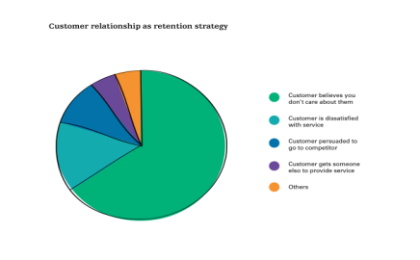
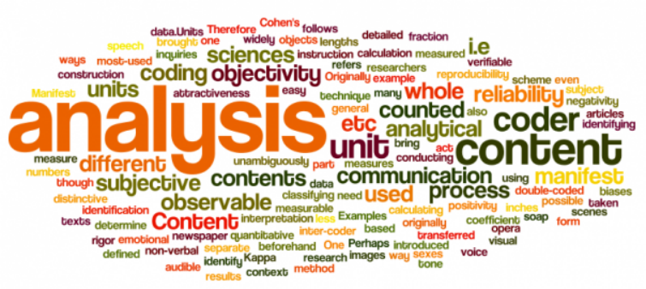
Review Analysis
IT16072848 - S.M.R.B Saluwadana
Customer behaviour towards offers will be identified.
By analyzing the customer reviews , merchants will be received data which will help to improve business.
Analyze customer behaviour & customer reviews will be used to create statistical data.
.

Slide 29
Self - Evaluation Plan
IT16072848 - S.M.R.B Saluwadana
Analyze customer behaviour on offers using a classification algorithm
Represent collected data in a statistical chart.
Analyze customer reviews using NL ToolKit.
Give recommendations and business ideas to merchants through merchants dashboard.
Create the most efficient & accurate algorithms to get suggestions according to customer reviews , by using the existing review analyzing algorithms.

Slide 30
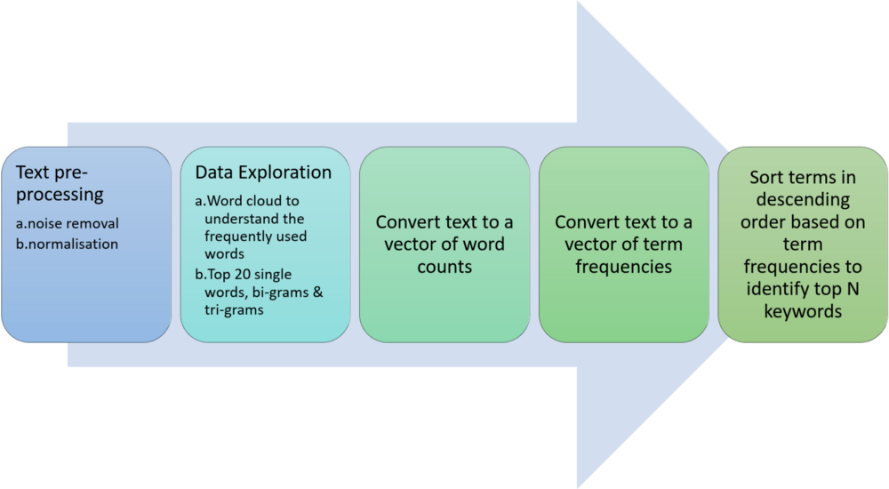
NLTK High-Level Approach
IT16072848 - S.M.R.B Saluwadana

Slide 31
Existing Algorithms
IT16072848 - S.M.R.B Saluwadana
Component | Existing Algorithms | Drawbacks
Analyze customer Behaviour | Naive Bayes Logistic Regression | Limited outcome variables Can’t solve non-linear problems with logistic regression algorithm
Analyze Reviews | CART algorithm Random forest algorithm | Prediction process using Random forest is time consuming

Slide 32







Technologies

Slide 33
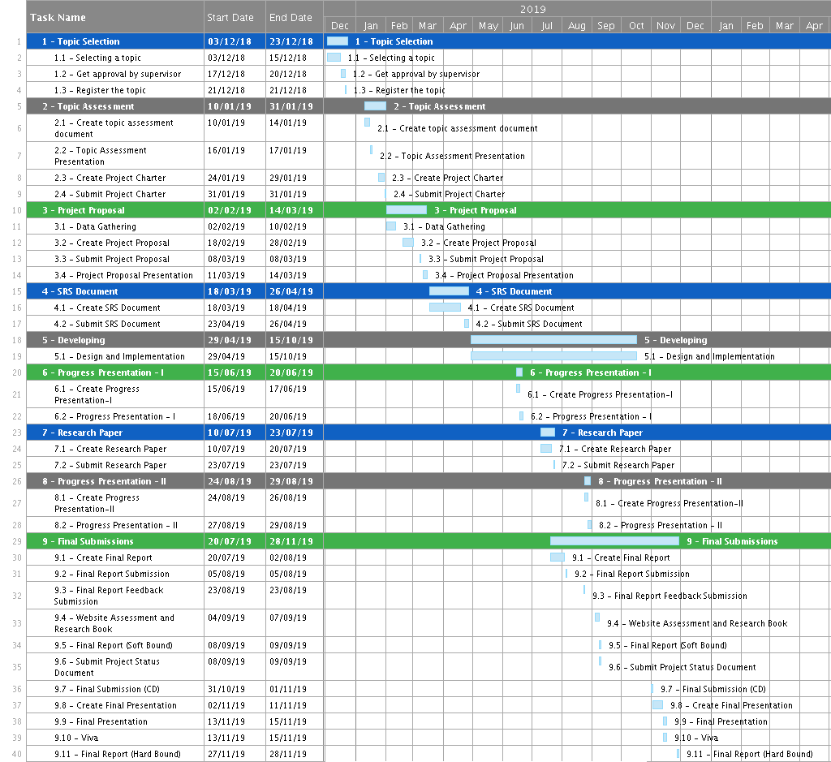
Gantt Chart

Slide 34
References
[1] H. Yoganarasimhan. (2017). “Search Personalization using Machine Learning”. [Online]. Available: https://faculty.washington.edu/hemay/search_personalization.pdf
[2] Sheethal S, J V Gorabal (2017) “Text Detection and Extraction from Images” [Online].Available: https://pdfs.semanticscholar.org/2e66/f1c01d039e8c152e03d0191e31a40ca4a068.pdf
Notes:
self evaluation

Slide 35
Thank You!

